Slide 1
Database Fundamentals & Design
Presented by
Josephine Boles

Slide 2
What is Normalization?
Normalization of data- a process that takes a table through a series of tests (normal forms) to certify the goodness of a design and thus to minimize redundancy and anomalies (insert, update, delete anomalies)
Notes:
database design may be performed using two approaches: bottom-up or top-down.
A bottom-up design methodology considers the basic relationships among individual attributes as the starting point and uses those to construct relation schemas (tables). This approach is not very popular in practice.
A top-down design methodology Perform a conceptual schema design using a conceptual model such as ER and map the conceptual design into a set of relations.
Normalization plays only a limited role in database schema design if a top-down modeling approach like the entity- relationship approach is used.
Normalization however plays a major role when the bottom-up approach is being used. Normalization is then essential to build appropriate relations to hold the information of the enterprise.

Slide 3
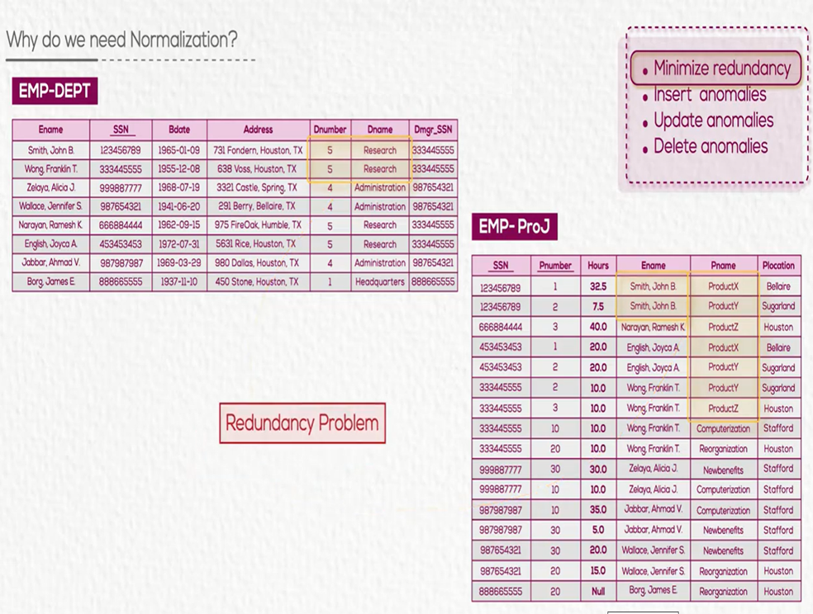
Storage
Performance
Size
Notes:
Four informal guidelines that may be used as measures to determine the quality of relation schema design:
Making sure that the semantics of the attributes is clear in the schema
Reducing the redundant information in tuples
Reducing the NULL values in tuples
Disallowing the possibility of generating spurious tuples
Guideline 1- Do not combine attributes from multiple entity types and relationship types into a single relation
Guideline 2- Design the base relation schemas so that no insertion, deletion, or modification anomalies are present in the relations
Guideline 3- As far as possible, avoid placing attributes in a base relation whose values may frequently be NULL
Guideline 4- Avoid relations that contain matching attributes that are not (foreign key, primary key) combinations because joining on such attributes may produce spurious tuples

Slide 4
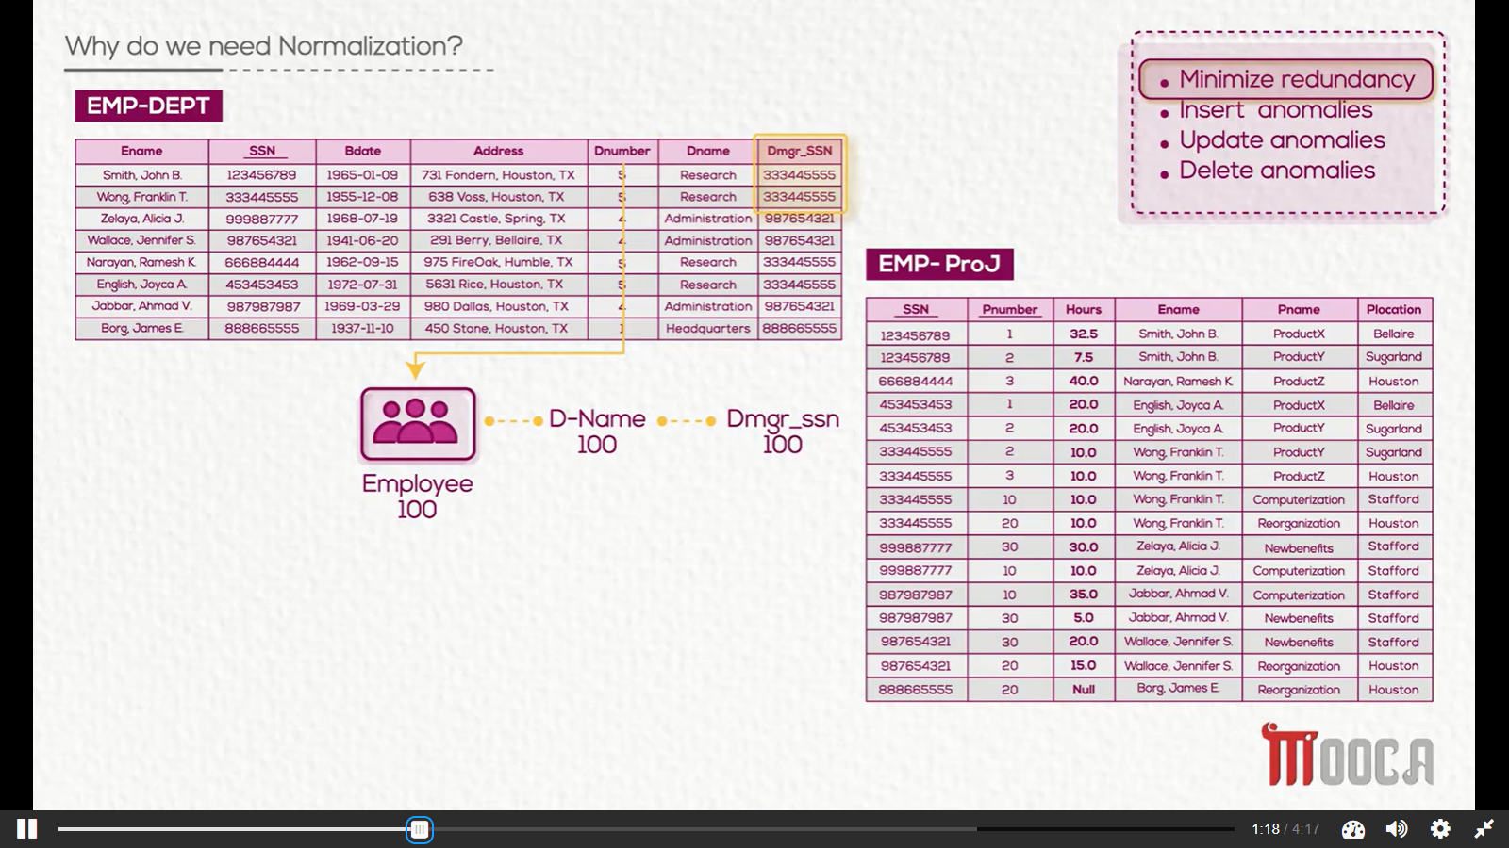
Why do we need Normalization?
Notes:
Four informal guidelines that may be used as measures to determine the quality of relation schema design:
Making sure that the semantics of the attributes is clear in the schema
Reducing the redundant information in tuples
Reducing the NULL values in tuples
Disallowing the possibility of generating spurious tuples
Guideline 1- Do not combine attributes from multiple entity types and relationship types into a single relation
Guideline 2- Design the base relation schemas so that no insertion, deletion, or modification anomalies are present in the relations
Guideline 3- As far as possible, avoid placing attributes in a base relation whose values may frequently be NULL
Guideline 4- Avoid relations that contain matching attributes that are not (foreign key, primary key) combinations because joining on such attributes may produce spurious tuples

Slide 5
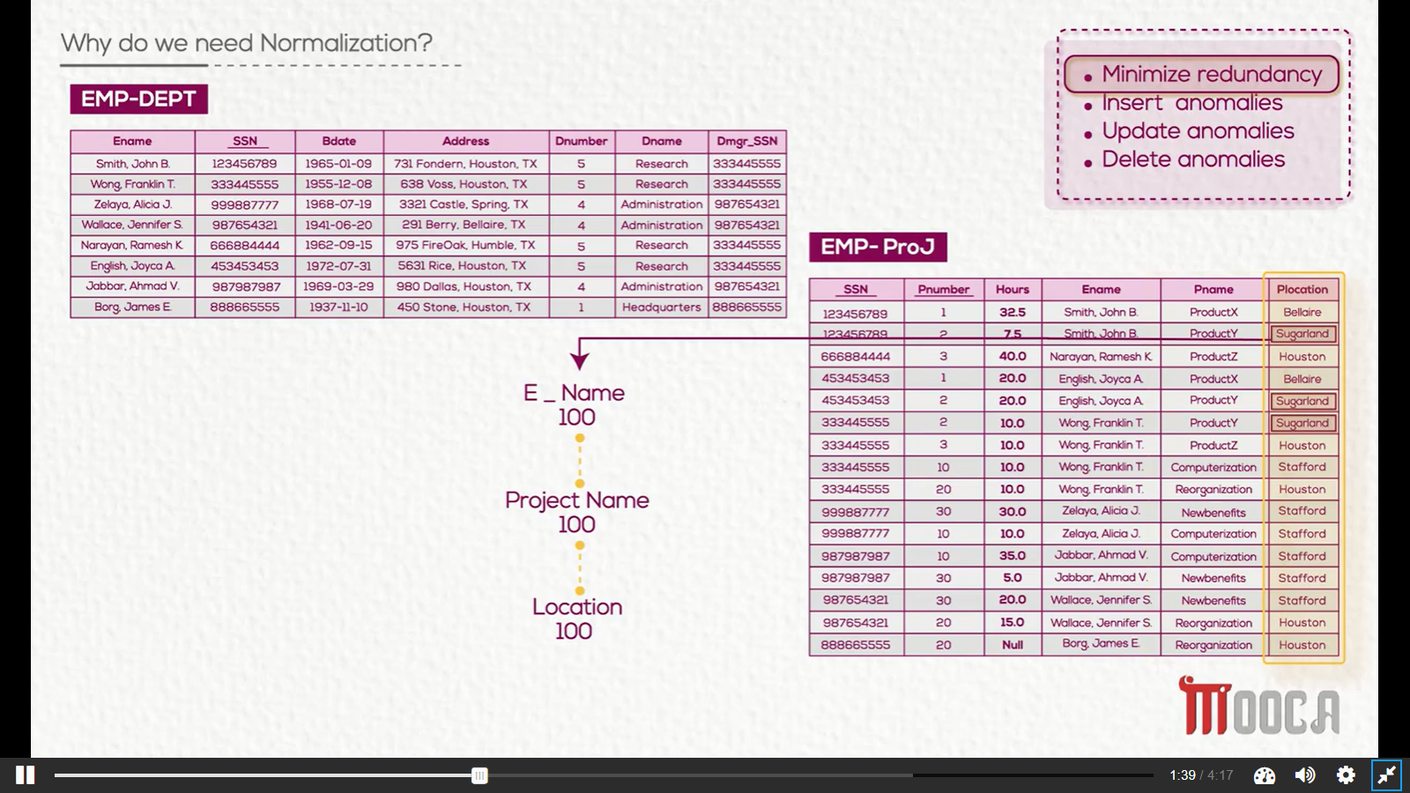
Why do we need Normalization?
Notes:
Four informal guidelines that may be used as measures to determine the quality of relation schema design:
Making sure that the semantics of the attributes is clear in the schema
Reducing the redundant information in tuples
Reducing the NULL values in tuples
Disallowing the possibility of generating spurious tuples
Guideline 1- Do not combine attributes from multiple entity types and relationship types into a single relation
Guideline 2- Design the base relation schemas so that no insertion, deletion, or modification anomalies are present in the relations
Guideline 3- As far as possible, avoid placing attributes in a base relation whose values may frequently be NULL
Guideline 4- Avoid relations that contain matching attributes that are not (foreign key, primary key) combinations because joining on such attributes may produce spurious tuples

Slide 6
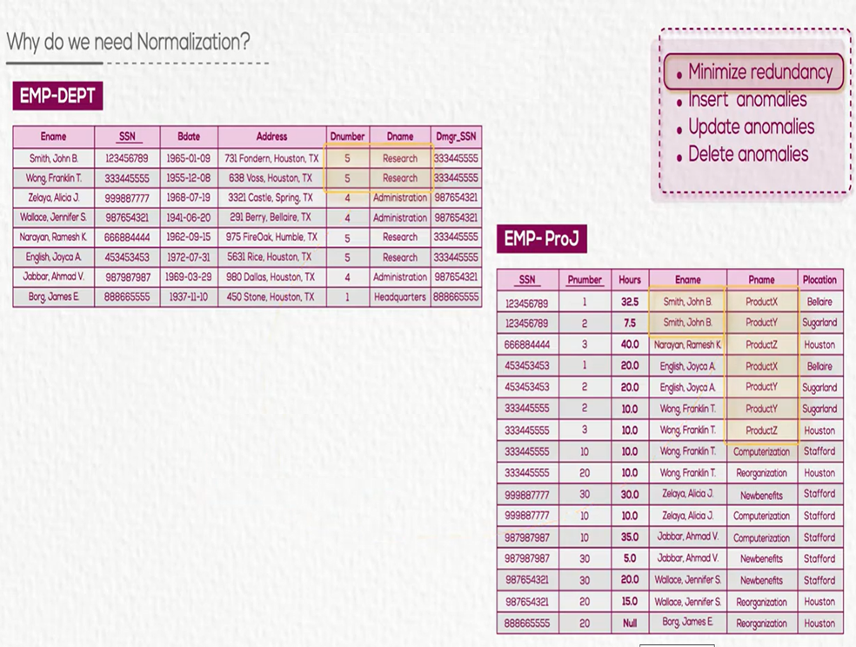
Why do we need Normalization?
Insert ssn & dnumber& dname
Insert ssn & pnumber & pname
Notes:
Four informal guidelines that may be used as measures to determine the quality of relation schema design:
Making sure that the semantics of the attributes is clear in the schema
Reducing the redundant information in tuples
Reducing the NULL values in tuples
Disallowing the possibility of generating spurious tuples
Guideline 1- Do not combine attributes from multiple entity types and relationship types into a single relation
Guideline 2- Design the base relation schemas so that no insertion, deletion, or modification anomalies are present in the relations
Guideline 3- As far as possible, avoid placing attributes in a base relation whose values may frequently be NULL
Guideline 4- Avoid relations that contain matching attributes that are not (foreign key, primary key) combinations because joining on such attributes may produce spurious tuples

Slide 7
Why do we need Normalization?
Update department data
Notes:
Four informal guidelines that may be used as measures to determine the quality of relation schema design:
Making sure that the semantics of the attributes is clear in the schema
Reducing the redundant information in tuples
Reducing the NULL values in tuples
Disallowing the possibility of generating spurious tuples
Guideline 1- Do not combine attributes from multiple entity types and relationship types into a single relation
Guideline 2- Design the base relation schemas so that no insertion, deletion, or modification anomalies are present in the relations
Guideline 3- As far as possible, avoid placing attributes in a base relation whose values may frequently be NULL
Guideline 4- Avoid relations that contain matching attributes that are not (foreign key, primary key) combinations because joining on such attributes may produce spurious tuples

Slide 8
Why do we need Normalization?
Delete
Notes:
Four informal guidelines that may be used as measures to determine the quality of relation schema design:
Making sure that the semantics of the attributes is clear in the schema
Reducing the redundant information in tuples
Reducing the NULL values in tuples
Disallowing the possibility of generating spurious tuples
Guideline 1- Do not combine attributes from multiple entity types and relationship types into a single relation
Guideline 2- Design the base relation schemas so that no insertion, deletion, or modification anomalies are present in the relations
Guideline 3- As far as possible, avoid placing attributes in a base relation whose values may frequently be NULL
Guideline 4- Avoid relations that contain matching attributes that are not (foreign key, primary key) combinations because joining on such attributes may produce spurious tuples

Slide 9
Normalization Avoids
Duplication of Data
Insert Anomaly
Delete Anomaly
Update Anomaly
Frequent Null Values
Notes:
Normalization avoids:
Duplication of Data – The same data is listed in multiple lines of the database
Insert Anomaly – A record about an entity cannot be inserted into the table without first inserting information about another entity – Cannot enter a department without an employee
Delete Anomaly – A record cannot be deleted without deleting a record about a related entity. If we delete from EMP_DEPT an employee tuple that happens to represent the last employee working for a particular department, the information concerning that department is lost from the database.
Update Anomaly – Cannot update information without changing information in many places. To update department information, it must be updated for each employee working in this department.
Using frequent Null values: Attributes that are NULL frequently could be placed in separate relations (with the primary key)

Slide 10
Functional Dependency
A constraint between two attributes (columns) or two sets of columns
A → B if “for every valid instance of A, that value of A uniquely determines the value of B”
Or …A →B if “there exists at most one value of B for every value of A”
It is read as: A determines B OR B depends on A.
The attributes on the left side of the arrow are called determinants
Notes:
Functional dependencies (FDs) are used to specify formal measures of the "goodness" of relational designs
FDs and keys are used to define normal forms for relations
FDs are constraints that are derived from the meaning and interrelationships of the data attributes
A set of attributes A functionally determines a set of attributes B if the value of A determines a unique value for B

Slide 11
Examples
Social security number determines employee name
SSN -> ENAME
Project number determines project name and location
PNUMBER -> {PNAME, PLOCATION}
Employee SSN and project number determines the hours per week that the employee works on the project
{SSN, PNUMBER} -> HOURS
Primary key is a determinant for the other columns.

Slide 12
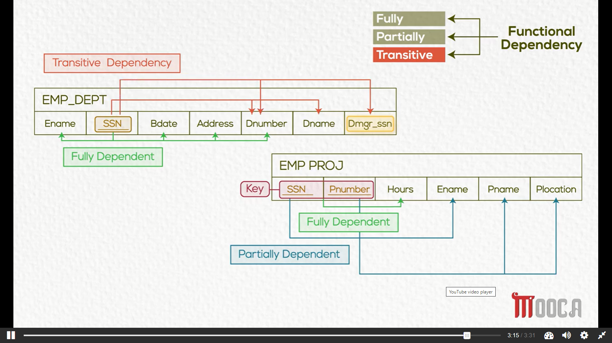
Notes:
FD1 and FD4 are Full Functional Dependency
FD2 and FD3 are Partial Functional Dependency
FD5 is Transitive Functional Dependency

Slide 13
Types of Functional Dependency
Full Functional Dependency- X → Y is a FFD if removal of any attribute A from X means that the dependency does not hold any more
Partial Functional Dependency- X→Y is a PFD if some attribute A ε X can be removed from X and the dependency still holds
Transitive Functional Dependency- X→Y in a relation R is a TFD if there exists a set of attributes Z in R that is neither a primary key nor a subset of any key of R, and both X→Z and Z→Y hold

Slide 14
Definition
Normalization: The process of decomposing unsatisfactory "bad" relations by breaking up their attributes into smaller relations
Normal form: Condition using keys and FDs of a relation to certify whether a relation schema is in a particular normal form
Notes:
Normalization is carried out in practice so that the resulting designs are of high quality and meet the desirable properties
The practical utility of these normal forms becomes questionable when the constraints on which they are based are hard to understand or to detect
The database designers need not normalize to the highest possible normal form. (usually up to 3NF, BCNF or 4NF)
Denormalization: the process of storing the join of higher normal form relations as a base relation—which is in a lower normal form

Slide 15
First Normal Form
A relation is in 1NF if it contains no multivalued, repeating groups or composite attributes
To put a relation in 1NF
Remove each repeating group and place it in a new table carrying the PK as a FK
Remove each multivalued attribute and place it in a new table carrying the PK as a FK
Put composite attribute subparts each in a column when necessary
Notes:
1NF- Disallows composite attributes, multivalued attributes, and nested relations (relations within relations); attributes whose values for an individual tuple are non-atomic considered to be part of the definition of relation. It states that the domain of an attribute must include only atomic (simple, indivisible) values
Repeating groups are nested relations (i.e. set of multivalued columns that are related to each other)

Slide 16
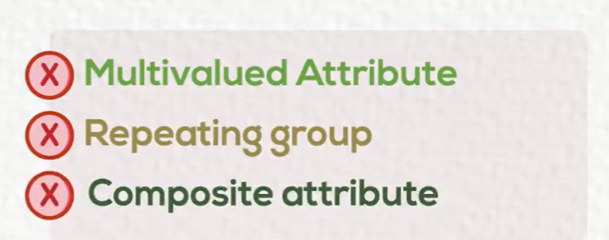
School Example
Stud_ID | Name | Location | Tel | Level | Level_Mgr | Subject | Subj-Desc | G
11 | Ali | Cairo | 010 | Primary | Noha M. | DB, CN | Database, Networks | A,B
22 | Mai | Giza | 011, 010 | Primary | Noha M | CN, DB | Networks, Database | B, C
33 | Marwa | Giza | 010 | Secon. | Moh.A. | SW, DB | Software, Database | A, A
Notes:
1NF
(Stud_ID, Name, Loc, Level, Level_Mgr)
(Stud_ID, Tel)
(Stud_ID, Subject, Subj_desc, Grade)
2NF
(Stud_ID, Name, Loc, Level, Level_Mgr)
(Stud_ID, Tel)
(Stud_ID, Subject, Grade)
(Subject, Subj_desc)
3NF
(Stud_ID, Name, Loc, Level)
(Level, Level_Mgr)
(Stud_ID, Tel)
(Stud_ID, Subject, Grade)
(Subject, Subj_desc)

Slide 17
School Example 1NF
Stud_ID | Name | Location | Level | Level_Mgr
Stud_ID | Tel
Stud_ID | Subject | Subject_Desc | Grade

Slide 18
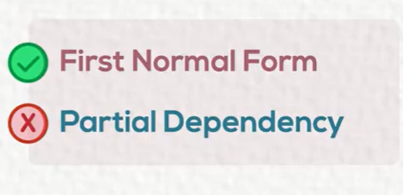
Second Normal Form
A relation is in 2NF if it is in 1NF and every nonkey
attribute is not partially dependent on the primary key
To put a relation in 2NF
Remove partial functional dependent non-keys carrying the key they depend on and place them in a new table

Slide 19
Guidelines
A relation is in 2NF if it is in 1NF and any one of these is true:
the PK consists of only 1 attribute
all attributes are part of the PK (no nonkey attributes)
every non key attribute is functionally dependent on the whole PK

Slide 20
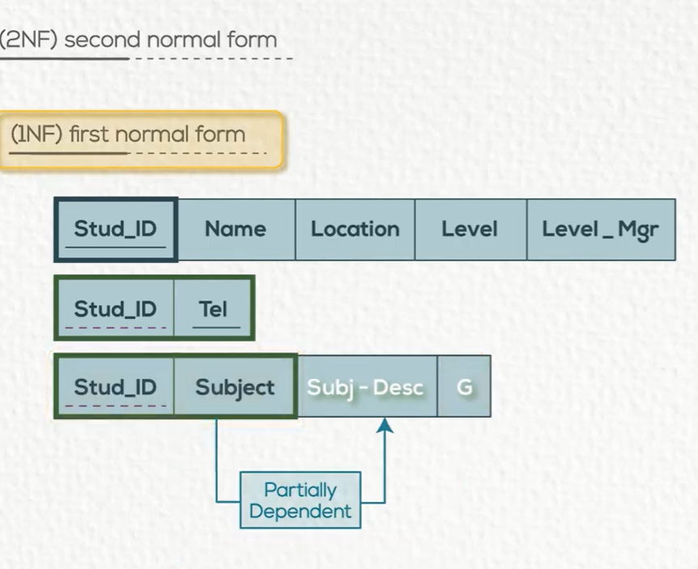

Slide 21
School Example 2NF
Stud_ID | Name | Location | Level | Level_Mgr
Stud_ID | Tel
Stud_ID | Subject | Grade
Subject | Subject_Desc

Slide 22
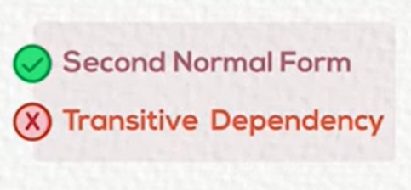
Third Normal Form
A relation is in 3NF if it is in 2NF and no transitive dependencies exist
To put a relation in 3NF
Remove the nonkey attributes carrying the nonkey attribute they depend on and place them in a new table. (Hint: leave the nonkey they depend on in the same table as well)

Slide 23
School Example 3NF
Student
Stud_ID | Name | Location | Level
Level
Level | Level_Mgr
Student_Tel
Stud_ID | Tel
Stud_Subject
Stud_ID | Subject | Grade
Subject
Subject | Subject_Desc

Slide 24
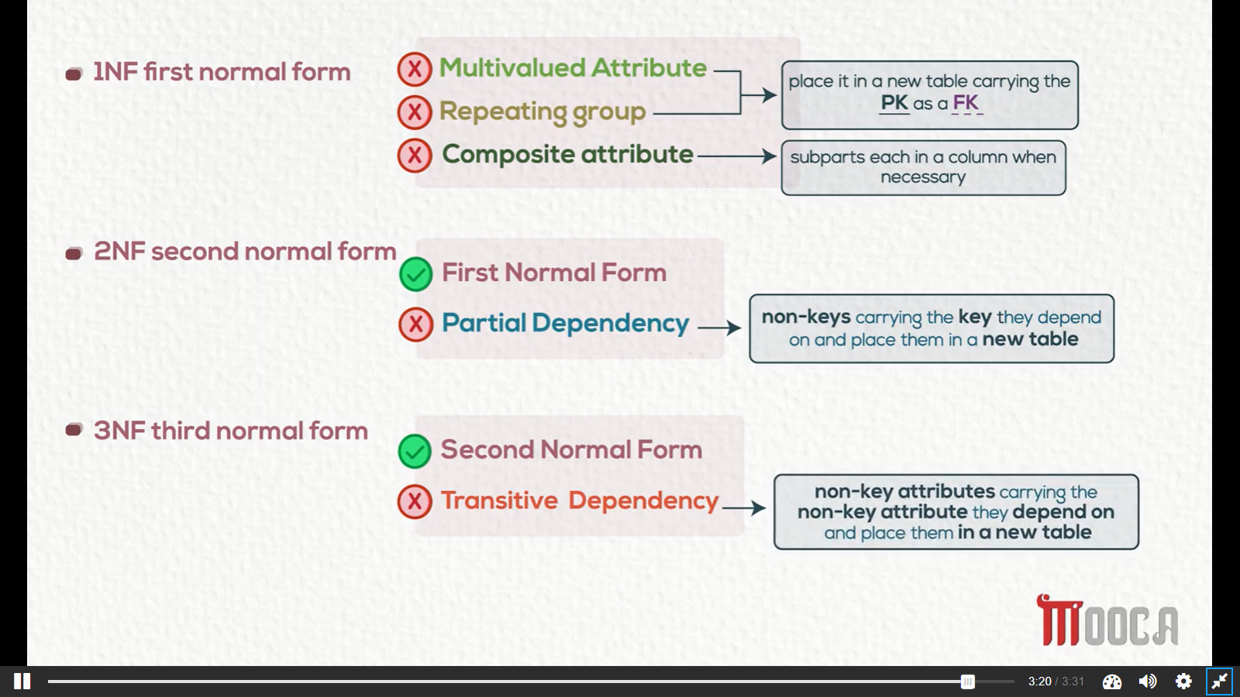

Slide 25
Notes:
0NF
Order (Cust_No,Cust_Name,Cust_Add, SO_No, SO_Date, Clerk_No, Clerk_Name, Item, Desc, Q, UP)
1NF
Cust_Order (Cust_No,Cust_Name,Cust_Add, SO_No, SO_Date, Clerk_No, Clerk_Name)
Order (SO_No, Item, Desc, Q, UP)
2NF
Cust_Order (Cust_No,Cust_Name,Cust_Add, SO_No, SO_Date, Clerk_No, Clerk_Name)
Order (SO_No, Item,Q)
Item (Item, Desc, UP)
3NF
Customer (Cust_No, Cust_Name,Cust_Add)
Clerk (Clerk_No, Clerk_Name)
Order (SO_No, SO_Date, Clerk_No,Cust_No)
Order_Item (SO_No, Item,Q)
Item (Item, Desc, UP)

Slide 26
1NF
Cust_Order (Cust_No, Cust_Name, Cust_Add, SO_No, SO_Date, Clerk_No, Clerk_Name)
Order (SO_No, Item, Desc, Quantity, Unit_Price)

Slide 27
2NF
Cust_Order (Cust_No,Cust_Name,Cust_Add, SO_No, SO_Date, Clerk_No, Clerk_Name)
Order (SO_No, Item,Quantity)
Item (Item, Desc, Unit_Price)

Slide 28
3NF
Customer (Cust_No, Cust_Name,Cust_Add)
Clerk (Clerk_No, Clerk_Name)
Order (SO_No, SO_Date, Clerk_No,Cust_No)
Order_Item (SO_No, Item,Quantity)
Item (Item, Desc, Unit_Price)

Slide 29
Questions ?

Slide 30

Exercises

Slide 31


